Slide 1
Java 9 Features – Part 1
New and Updated Features
【NCOS Internal Use Only】
Global Delivery Center Philippines
NEC Telecom Software Philippines, Inc.
December 06, 2017

Slide 2
Notes:
＃本スライドの活用について
NECグループのブランドステートメント「Orchestrating a brighter world」は、ステークホルダーへの約束として、NECグループの企業姿勢、実現したい世界観と、それに対する自らの「行動・能力」を表現したものです。
社外向け発信活動においては、必ず表紙の次ページに本スライドを挿入し、ブランドステートメントとともにどんなストーリーを展開するかを説明するように心掛けてください。
＜セリフ例＞-----
私たちNECグループは、お客さまや社会と共創して、社会価値を創造していきます。
人が生きる、豊かに生きる、そして明るい未来につなげていくために。
これをブランドステートメント「Orchestrating a brighter world」としました。
NECグループが目指しているこの方向性の中で、本日は、○○○を実現する具体的な取り組み（ソリューション、サービス、技術）についてご説明します。
-----------------
※そのほか、言葉に込めた意味、マークデザインに込めた意味については、「NEC Brand Principles」で確認してください。

Slide 3
Java 9 Features – Part 1
1. Modular JDK and Modular Source Code
2. Module System
3. JShell
4. Encapsulate Most Internal APIs
5. Launch-Time JRE Version
6. Multi-Release JAR Files

Slide 4
1. Modular JDK and Modular Source Code
New Feature

Slide 5
1. Modular JDK and Modular Source Code
The JDK 9 has been modularized through the Java Platform Module System. It is divided into sets of modules that can be combined at compile time.
The modular source code is the new source code layout for the JDK. The layout may also be applied outside JDK, but not necessarily designed as a broadly-universal modular source code layout.
The entire JDK source code was divided into smaller modules since previous jar files were too big, especially rt.jar. By reorganizing the source code, it gives JDK developers the chance to become familiar with the modular structure system.

Slide 6
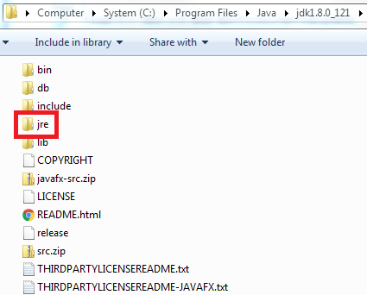
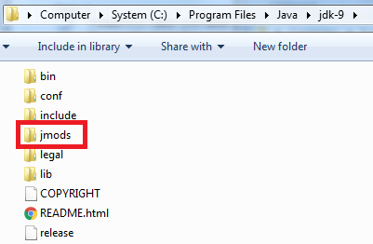
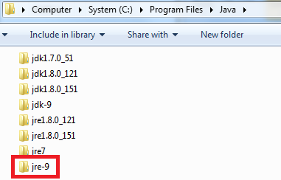
1. Modular JDK and Modular Source Code
Comparison between JDK8 and JDK9
  When installing Java 9 using JDK installer, it already includes the JRE. But when installed, JRE is separated in a separate distribution folder. Instead, it now contains a new folder jmods, which contains a set of Java 9 modules. After installation, the folder contents look like below:
*JDK 8 – already includes JRE after installation
*JDK 9 – no more JRE and with new folder jmods
*JRE 9 – in a separate folder after installing JDK 9

Slide 7
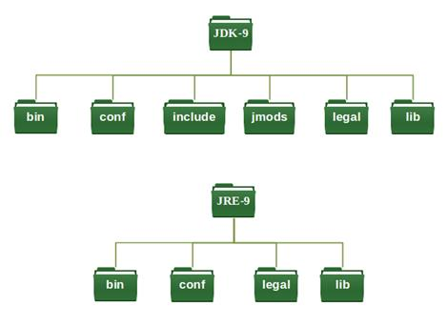
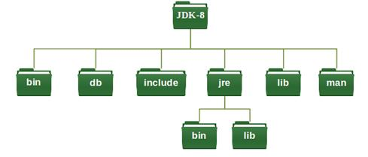
1. Modular JDK and Modular Source Code
  Consider the folder structures below:
  In JDK 9, JRE is now in a separate directory unlike JDK8 (and other previous versions). Both JDK 9 and JRE 9 structure have the same folders except that in JDK, it has 2 more folders: jmods and include.
  Since Java 9 is divided into sets of modules, these modules are stored in the jmods directory.
  tools.jar and rt.jar are removed together with other various internal jar files, which are now stored in a more efficient format. The format of these files are not specified and is subject to change without notice.

Slide 8
1. Modular JDK and Modular Source Code
References
  https://www.developer.com/java/java-9-structural-changes-in-the-jdk-and-jre.html
  https://www.journaldev.com/13106/java-9-modules
  http://openjdk.java.net/jeps/200
  http://openjdk.java.net/jeps/201

Slide 9
2. Module System
New Feature

Slide 10
2. Module System
The Java Platform Module System introduces a new programming component which is the module.
A module is a collection of code. It holds classes, data, and other modules in the form of dependencies. Each module contains module-info.java to set necessary information.
  How does it work?
  There are 2 main keywords in the module-info.java file: requires and exports. In the example above, it states that Module1 depends on Module2 and nothing else. For Module2, it states that everything within org.example1 only, including its classes and packages, are visible to other modules. Other than that, remaining items are not exposed and cannot be accessed by other modules.
Module1
Module2
com.example1
org.example1
com.example2
org.example2
module-info.java
module-info.java
Only org.example1 is accessible to other modules
Module1 dependent on Module 2
module Module1 {
requires Module2;
}
module Module2 {
exports org.example1;
}

Slide 11
2. Module System
  Why are modules useful?
    There are certain problems in developing or delivering Java based applications in previous Java versions. These problems are:
    As JDK is too big, it is a bit tough to scale down to smaller devices, Java SE 8 introduced 3 types of compact profiles: compact1, compact2, compact3. But this does not solve the problem.
    JAR files, like rt.jar etc., are too big to use in small devices and applications.
    As JDK is too big, applications or devices are not able to support better performance.
    There is no strong encapsulation in the previous versions because the public access modifier is too open. Everyone can access it. Setting accessibility type of public to a type means global accessibility.
    As JDK, JRE is too big, it is hard to Test and Maintain applications.
    As public is too open, the y are not to avoid the accessing of some internal non-critical APIs.
    As user can access internal APIs too, security issues arise.
    Applications are too big.
    A bit tough to support less coupling between components.
    To address these issues, Java Module System was released. It was scheduled to be released with Java 7, some “baby steps” in Java 8 and finally released in Java 9. The delay of the release was due to the controversial acceptance of Project Jigsaw by the Java Executive Committee.

Slide 12
2. Module System
  The release of the Java Module System brings big benefits to developers. These benefits are (but not limited to):
    As JDK, JRE, JARs etc., are divided into smaller modules, we can use whatever modules we want. It is now easy to scale down the Java application to smaller devices.
    Ease of Testing and Maintainability.
    Supports better performance.
    As public is not entirely public, it supports strong encapsulation. It needs to meet simultaneously the following conditions, for example, when accessing type called T:
      The package containing type T has to be exported
      The module that needs access to type T has to read the modules containing type T.
      Type must have a public modifier
    We cannot access internal non-critical APIs anymore.
    Modules can hide unwanted and internal details safely; meaning better security.
    Applications are small since we can use only whatever modules are needed.
    It is easy to support less coupling between components.
    It is easy to support Single Responsibility Principle (SRP).

Slide 13
2. Module System
References
  https://blog.idrsolutions.com/2017/05/java-9-modularity-explained-in-5-minutes/
  https://www.journaldev.com/13106/java-9-modules
  http://openjdk.java.net/jeps/261

Slide 14
3. JShell
New Feature

Slide 15
3. JShell
The JShell is an interactive tool that provides a command-line interface. It is a Read-Evaluate-Print-Loop (REPL) that can evaluate a few lines of code as standalone and immediately show the results, without the need to create a method or project.
How does it work?
  The JShell is part of the JDK as a command-line tool, the same with tools like javac, jconsole, jstat, etc. To use this tool, JDK 9 must be installed in the system.
  JShell tool is included in the JDK installers in the following platforms:
    Oracle Solaris
    Microsoft Windows
    Linux
    macOS

Slide 16
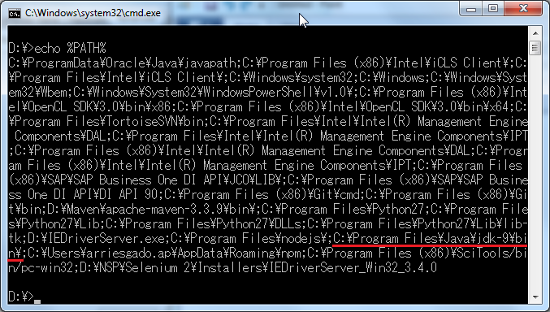
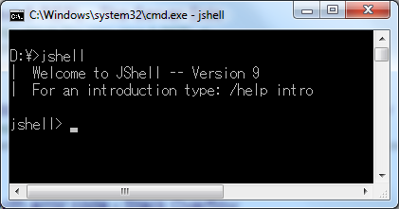
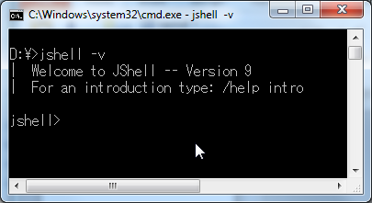
3. JShell
  Starting and stopping
    Set system path to include the java bin path (<java-home>/jdk-9/bin).
  *After setting system path.
  After the java bin path is included in the directory, enter the jshell command on the command line. To start in verbose mode, use the –v option.
  *verbose mode

Slide 17
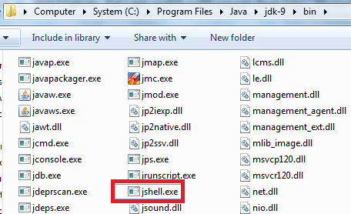
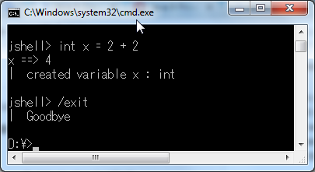
3. JShell
  If the java bin path is not included in the system path, start the tool from the java bin path.
  *Double click on the jshell executable file jshell.exe to start.
  To exit from Jshell, enter /exit:

Slide 18
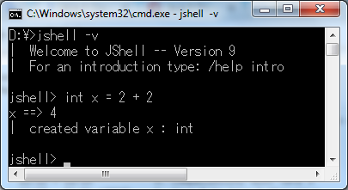
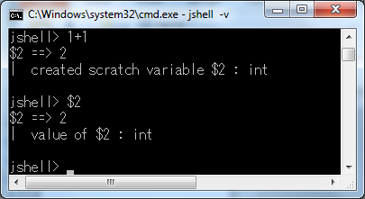
3. JShell
  Try out snippets
  By entering the sample statement below, an immediate output is shown:
  *In this example, it is read as:
  variable x has the value of 4. Since it is in verbose mode, a description of what occurred is also shown.
  When an expression is entered that doesn’t have a named variable, a scratch variable is created that can be referenced later. For example:
  *The result of the expression 1+1 is stored in a scratch variable $2. When $2 is referenced, it returns the value 2.

Slide 19
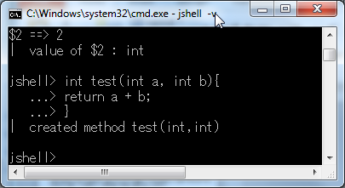
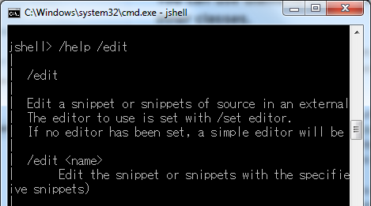
3. JShell
  For snippets requiring more than one line of input, continuation prompt (...>) is shown after hitting Enter. For example:
  *...> shows that the snippet needs more lines of input.
  Using commands
  Commands are distinguished from snippets by a leading forward slash (/).
  By using /help, a list of JShell commands and a brief description of each command will be shown. To view more about the command, use /help <command>.
  Ex:
  *By using /help /edit command, it shows more /edit command’s details. It displays some description of each of the items.
  The amount of typing may also be reduced by using the abbreviated commands. Commands, /set subcommand, command arguments, and command options can all be abbreviated, as long as the abbreviation is unique

Slide 20
5. Jshell
References
  https://docs.oracle.com/javase/9/jshell/introduction-jshell.htm#JSHEL-GUID-630F27C8-1195-4989-9F6B-2C51D46F52C8
  https://stackify.com/java-9-jshell/
  http://openjdk.java.net/jeps/222

Slide 21
4. Encapsulate Most Internal APIs
New Feature

Slide 22
4. Encapsulate Most Internal APIs
Encapsulating internal APIs improves the integrity and security of the Java Platform. By default, these APIs are inaccessible at compile time, and in a future release, it will be inaccessible at runtime.
JDK’s internal APIs are divided into 2 broad categories:
    Non-critical internal APIs
      Do not appear to be used by code outside of the JDK or are used by outside code merely for convenience. i.e. for functionality that is available in supported APIs or can easily be provided by libraries. These APIs are encapsulated in JDK 9.
    Critical internal APIs
      Provides critical functionality that would be difficult, if not impossible, to implement outside of the JDK itself. APIs with supported replacements are deprecated and will be either encapsulated or removed in future release.
  Internal APIs that are encapsulated can be made accessible at compile time via the –add-exports command line options.

Slide 23
4. Encapsulate Most Internal APIs
Critical Internal APIs not encapsulated
  There are critical internal APIs that are not encapsulated in JDK9 because no supported replacements exist in JDK8. The APIs are defined in and exported by the JDK-specific jdk.unsupported module.
  These APIs are listed below:
    sun.misc.{Signal, SignalHandler}
    sun.misc.Unsafe
    sun.reflect.Reflection::getCallerClass(int)
    sun.reflect.ReflectionFactory
    com.sun.nio.file.{ExtendedCopyOption, ExtendedOpenOption, ExtendedWatchEventModifier, SensitivityWatchEventModifier}
  These APIs are accessible by default to code on the class path, and accessible to code in modules if those modules declare dependencies upon the jdk.unsupported module.
  Users that maintain libraries that use critical internal APIs for which replacements exist, may use the MRJAR files in order to ship single artifacts that use the old APIs on releases prior to JDK 9 and the replacement APIs on later releases.

Slide 24
4. Encapsulate Most Internal APIs
Effects of using internal APIs in Java 9
    Non-critical internal APIs
      Existing code depending on APIs previously present in sun.misc & sun.reflect packages may not work properly.
    Critical internal APIs
      If some widely-used critical internal API was not identified as critical, then applications that depend upon it will fail.
      If some widely used critical internal API was not used but still exists, then applications that depend upon it will may issue warning and will fail in future release.

Slide 25
4. Encapsulate Most Internal APIs
Reference
  https://www.voxxed.com/2016/11/java-9-series-encapsulate-internal-apis/
  http://openjdk.java.net/jeps/260

Slide 26
5. Launch-Time JRE Version
Updated Feature

Slide 27
5. Launch-Time JRE Version
Modern applications are typically deployed through Java Web Start (with a JNLP file), native OS packaging systems, or active installers, and all of theses technologies have their own ways of finding, and even sometimes installing and later updating an appropriate JRE for the application. This makes the launch-time JRE version selection obsolete.
The ability to request, at JRE launch time, a version that is not the JRE being launched is no longer possible. The launcher was modified as follows:
    An error message is emitted and will exit if the –version: option is given on the command line
    A warning message is emitted and will continue if the JRE-Version manifest entry is found in a jar file.

Slide 28
5. Launch-Time JRE Version
Reference
  http://openjdk.java.net/jeps/231

Slide 29
6. Multi-Release JAR Files
New Feature

Slide 30
6. Multi-Release JAR Files
Multiple Java-release-specific versions of class files are allowed to coexist in a single archive.
A JAR file has a content root, which contains classes and resources, as well as a META-INF directory which contains metadata about the JAR. JAR format can encode, in a compatible way, multiple versions of a library for different target Java platform releases by a versioned metadata specific to groups of files the JAR format can encode.
A multi-release JAR (MRJAR) will contain additional directories for classes and resources specific to particular Java platform release. Typically, a JAR library looks like this:
  jar root
  - A.class
  - B.class
  - C.class

Slide 31
6. Multi-Release JAR Files
  Suppose class A needs an alternative version. The attribute Multi-Release: true is added to MANIFEST.MF before the JAR becomes a MRJAR. The new JAR can be bundled as follows:
  jar root
  - A.class
  - B.class
  - C.class
  - META_INF
  - versions
  - 9
  - A.class
  - B.class
  - 10
  - A.class
  JDKs that do not support MRJARs will only see classes and resources in the root directory and ignore other packaging. Otherwise, it will look for the classes and resources first in the platform corresponding to the current running major Java root, then search those for lower versions, and finally the JAR root.

Slide 32
6. Multi-Release JAR Files
Reference
  http://openjdk.java.net/jeps/238

Slide 33
Revision History
Version Number | Date | Author | Reviewer | Description
00.01 | 2017/11/10 | NSP-arriesgado.ap | NSP-sgo | Initial Creation
02.00 | 2017/11/17 | NSP-arriesgado.ap | NSP-sgo | Added and updated images and content information; added references
03.00 | 2017/11/18 | NSP-arriesgado.ap | NSP-sgo | Added content information
03.01 | 2017/12/06 | NSP-arriesgado.ap |  | Section 6 example update

